Slide 1

SMART HOME AUTOMATION
By
S.KANISHMA(192211289)
Guided by
DR.K.JAYASAKTHI VLEMURUGAN

Slide 2

Agenda
Objective of the project
Existing System and Its Drawbacks
Proposed System and Its Advantages
Architecture diagram
Listed modules and Description
Conclusion and Future Enhancement
References

Slide 3

INTRODUCTION
OBJECTIVE OF THE PROJECT
The primary objective of this project is to design and implement a smart home automation system using Java that enables users to control various home appliances through a centralized interface. The system aims to enhance convenience, improve energy efficiency, and provide remote access to home devices through a mobile or web application.

Slide 4

EXISTING SYSTEMS AND ITS DRAWBACKS
Drawbacks:
Existing Systems:
Limited Customization: Existing systems often offer limited customization options for users.
Vendor Lock-in: Users may be locked into specific ecosystems, making it challenging to integrate devices from different manufacturers.
High Cost: Many commercial solutions can be expensive, requiring additional subscriptions or fees.
Privacy Concerns: Some systems may have privacy issues related to data collection and usage.
Many smart home systems are available, such as Google Home, Amazon Alexa, and Apple Home Kit.

Slide 5

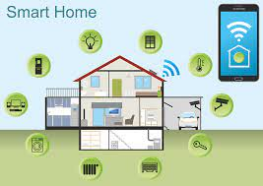
PROPOSED SYSTEM AND ITS ADVANTAGES
PROPOSED SYSTEM
ADVANTAGES
A customizable smart home automation system developed in Java, allowing users to control devices from various manufacturers through a unified interface.
Enhanced Privacy
Cost Effective
Vendor Independence
Customizability

Slide 6
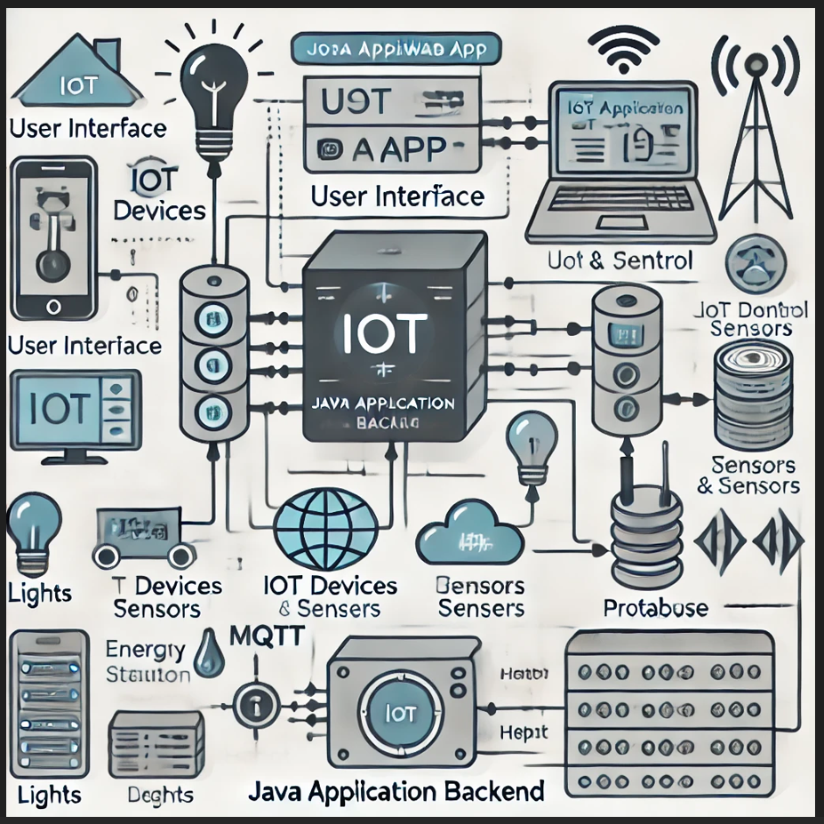
ARCHITECTURE DIAGRAM
1

Slide 7
LISTED MODULES
1.User Authentication Module:
Description: The User Authentication Module is responsible for managing secure access to the smart home automation system.
2.Device Control Module:
Description: The Device Control Module allows users to monitor and control various smart home devices (e.g., lights, thermostat, cameras) from a centralized interface.
3.Scheduling Module:
Description: The Scheduling Module allows users to schedule operations for their smart home devices.
User Authentication Module
Device Control Module
Scheduling Module
Notifications Module
Data Analytics Module
4.Notifications Module:
Description: The Notifications Module sends alerts and status updates to users about their smart home devices.
5.Data Analytics Module:
Description: The Data Analytics Module provides users with insights into their energy consumption and device usage patterns.

Slide 8
CONCLUSION AND FUTURE ENHANCEMENTS
CONCLUSION
FUTURE ENHANCEMENTS
The smart home automation system built using Java provides users with a flexible, customizable, and cost-effective solution to manage their home devices.
By addressing the drawbacks of existing systems, this project promotes greater user control and privacy.
Integration with AI: Implementing machine learning algorithms for predictive analytics and smart suggestions.
Voice Control: Adding voice recognition features for hands-free control.
Enhanced Security: Implementing advanced security features to safeguard user data.

Slide 9
REFERENCES
• Java Programming for IoT Systems, XYZ Publisher
• Smart Home Automation Technologies, ABC Institute
• Official Oracle Java Documentation
• Spring Framework Documentation
• The Internet of Things: Key Applications and Protocols by John Wiley & Sons
• Java Design Patterns for IoT Applications by PQR Publications

